Slide 1
Oracle to Graph Sync-Business Rules
October 18, 2016

Slide 2
Oracle to Graph Sync-Business Rules
Intro:
Demo: VBC User Role change/User Create synced with Graph, Hawtio to control
Rules Microservice, Rule Review, (Kie Server) deep dive
Kie Workbench…Testing the rules
Rules beyond Oracle sync to Neo4j

Slide 3


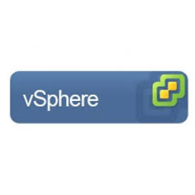
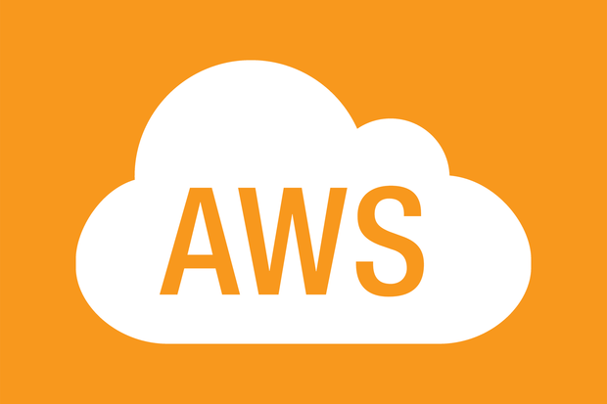
Oracle data flow to Neo4j
2.1 Wait, check again in a bit
Oracle Reporting
ESG (WiseGate)
1. Changes Ready?
Odata
Open Data Protocol
Apache Camel: Change detection
3. Put to Change Data queue
2. Change data response
5. Send in Oracle POJOs
Kie Server: Sync Rules
Apache Camel: Data enrichment
6. Get out Neo4j POJOs
4. Get Change Data Payloads
7. Put to Graph Cypher queue
(DevSpace)
Apache Camel: Cypher runner
9. Merge onto Neo4j
8. Get Graph Cyphers
Wisegate Graph
(Neo4j)
Master Only
(Clustered)

Slide 4
Rule authoring, deployment with Kie Workbench and Postman execution of Microservice
Review Kie Workbench rule authoring packaging and artifacts.
Inbound payload to
{ "commands":[ { "insert":{ "out-identifier":"upm", "return-object":"true", "object": { "com.verizon.wisegate.neo4j.data.objects.UserPermissionMap":{ "userId":"Q2CSFU3R0QPHD", "permissionId":"VECSR-POC", "timestamp":1476057600000, "historyType":"ADD", "status": "Inactive" } } } }, { "insert":{ "out-identifier":"rel", "return-object":"true", "object": { "com.verizon.wisegate.neo4j.data.objects.Neo4JRelationship":{} } } }, { "fire-all-rules":"" } ] }

Slide 5
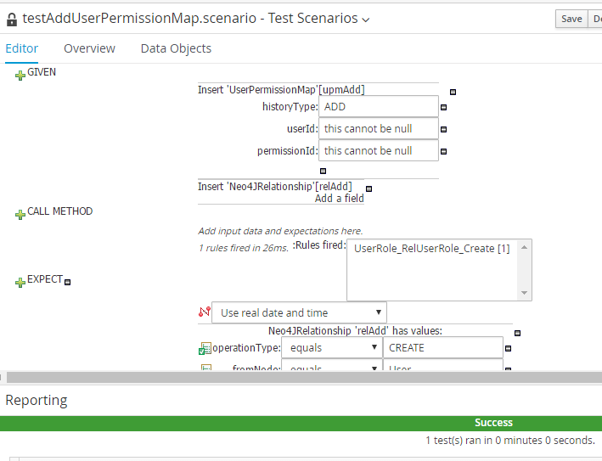
Testing Rules: see what’s firing

Slide 6
Usage beyond Oracle sync to Neo4j
New data streams, new data objects (eg. invoices)
Data Privacy, CPNI trust boundary monitoring.(backward chaining)
How can the customer avoid the next access request
Entitlement remapping, auto grouping.
Product catalogue, service uptake events and auto entitlement.

